Slide 1


Dynamic VBA Solution for Annual Sales, Delivery, and Payment Analysis
Tommy O’GORMAN (K00301970)

Slide 2





Overview of Presentation
Project Goals/Decisions
Comparative analysis of sales, deliveries, and payments.
Automate reporting with a dynamic VBA solution.
Key Deliverables
SLA Compliance: Delivery performance by location.
Comparative Analysis: Monthly sales and payments.
Historical Trends: Past vs. current data.
Dashboard: Actionable insights.
Demonstration
Show dynamic VBA solution in action.
Key Insights
Highlight decisions, challenges, and resolutions.

Slide 3
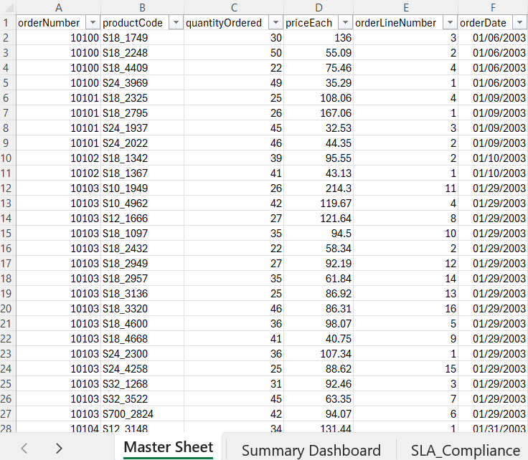
Dataset Overview
Data Sources
Raw data from multiple spreadsheets
Customers.csv, orders.csv, orderdetails.csv, etc.
Contains sales, delivery, and payment data for analysis.
Data Consolidation
A macro integrates all raw datasets into a single workbook.
Key columns from each sheet are extracted and loaded into the Master Sheet.
Feature Engineering
New columns derived from raw data, including:
timeFrameForDeliveries, internalStatus, Year, Month, buyPrice, Revenue, ProfitPercentage, and Profit>Median.
Notes:
the data.

Slide 4
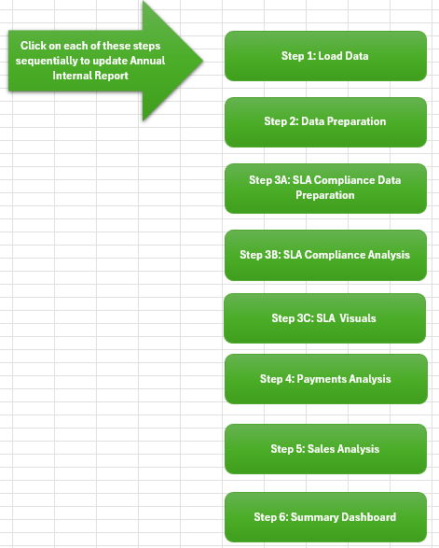
VBA Solution Demonstration
Key Macros Demonstrated: Macro_01_LoadData: Imports raw data and clears outdated entries, ensuring clean data for analysis.
Macro_05_SLAMacro1_PopulateSLACompliance: Populates SLA compliance data, forming the foundation for SLA analysis.
Macro_11_PaymentsAnalysisMacro1_CreatePaymentsAnalysisStructure: Sets up the Payments Analysis tab with headers and structure.
Macro_15_Create_Summary_Dashboard_With_Chart_Structures: Builds the framework for the Summary Dashboard.
Macro_17_Apply_All_Conditional_Formatting: Applies color-coded formatting for easy interpretation of trends and deviations.

Slide 5
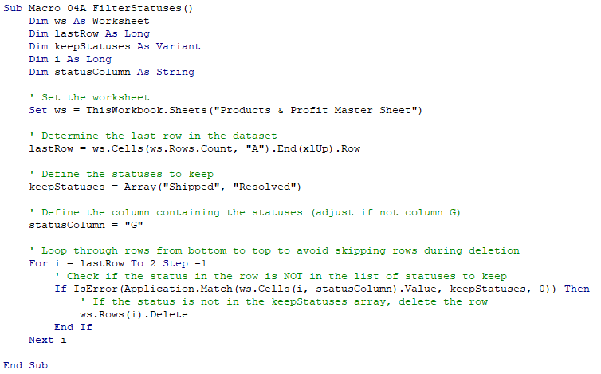
Code Walkthrough
Macro 1: Macro_01_LoadData
Purpose: Automates the loading of raw data into relevant worksheets (e.g., Orders, Payments, Customers).
Key Features:
Clears outdated entries dynamically before importing new data.
Loads data from external CSV files into corresponding tabs.
Ensures the workbook starts with clean, up-to-date data
Macro 4A: Macro_04A_FilterStatuses
Purpose: Automates filtering of data by removing irrelevant statuses, streamlining the analysis process.
Key Features:
Retains only specified statuses (e.g., "Shipped", "Resolved") and removes others.
Ensures clean and relevant data by dynamically adjusting to the dataset size.
Code Highlight: Efficiently loops through data bottom-up, ensuring accurate row deletion without errors.
Macro 6: Macro_06_SLAMacro2_IdentifyYearsBasedOnMonths
Purpose: Automates the identification of full years (12 months of data) and the current year (incomplete data) to ensure accurate year-on-year comparisons.Key Features:
Dynamically counts months per year in the dataset to identify complete and incomplete years.
Categorises two full years as "Historical Year 1" and "Historical Year 2" and flags the current year as incomplete.
Outputs the identified years directly into the SLA Compliance tab for further analysis.

Slide 6
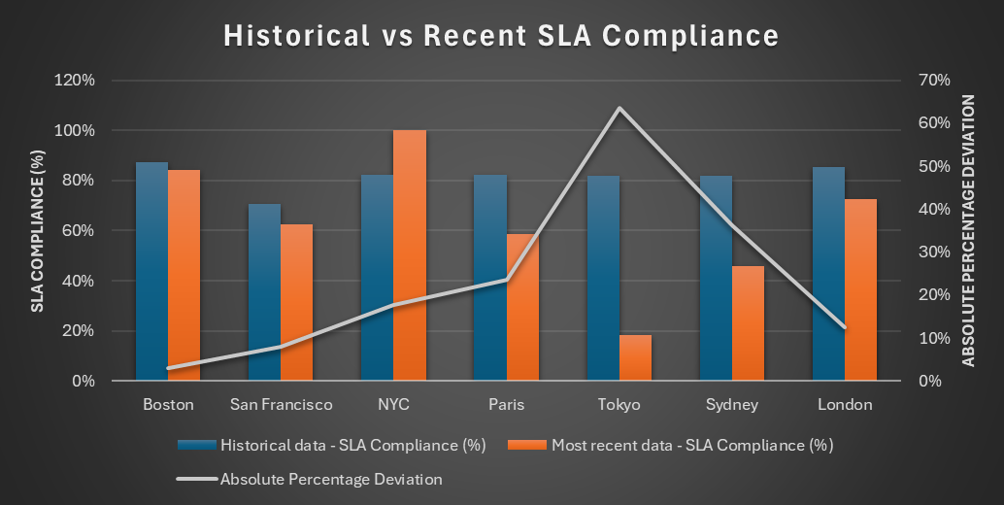
SLA Compliance Analysis
Purpose:
Assess delivery performance against SLA (6 days) to identify operational strengths and weaknesses.
Metrics:
SLA Compliance (%): Measures on-time deliveries relative to total deliveries.
Contribution to Total On-Time Deliveries (%): Quantifies each office's impact on overall compliance.
Insights:
Boston (87%) and London (85%) are consistent performers.
San Francisco (63%) and Tokyo (18%) need attention.
Seasonal dips in July and August highlight potential resource challenges.
Notes:
Speaker Notes:
Explain why these metrics are used (standardization, operational impact).
Highlight key trends shown in the graph (e.g., Tokyo's sharp decline).
Connect insights to recommendations for resource allocation improvements.

Slide 7
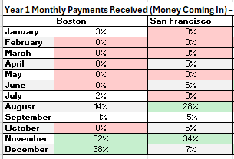
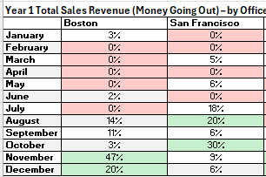
Comparative Analysis
Purpose:
Compare performance across months and offices to uncover trends and areas needing attention.
Metrics:
Monthly SLA Probabilities: Uses historical data to calculate likelihood of future compliance.
Example of Formula used: (Number of On-Time Deliveries in Month X across a certain year) / (Total on time Deliveries across that year).
Monthly Sales and Payments Trends: Month-wise aggregation of sales (quantity × price) and payment values.
Key Decisions:
Why Relative Frequency? Ensures fair comparison across offices with different workloads.
Why Monthly Trends? Highlights seasonality and potential cashflow issues.
Notes:
One of the key features of this workbook is its ability to track and compare payments (money in) against sales revenue (money out) on a monthly basis.
This ensures the business can identify potential cash flow issues early by highlighting periods where inflows don’t align with outflows, such as Boston in November and December.
Other content if needed:
Seasonal Trends:
Certain months consistently show higher sales revenue (money out) but relatively lower payments received (money in), suggesting a potential seasonal lag in collections. This could be critical for businesses to manage operational cash flow.
Office Contribution Insights:
Some offices consistently contribute more to overall payments and revenue, indicating stronger customer engagement or market presence. Highlighting top-performing locations could guide strategic focus.
Discrepancies in Probabilities:
Monthly SLA compliance probabilities might show gaps in performance consistency. For instance, offices with higher probabilities in some months and lower in others could signal operational inefficiencies or resource constraints.
Payment Consistency:
Offices with consistent "money in" trends could be better aligned with collections processes. This can be benchmarked against offices with fluctuating trends to optimise collection strategies.

Slide 8
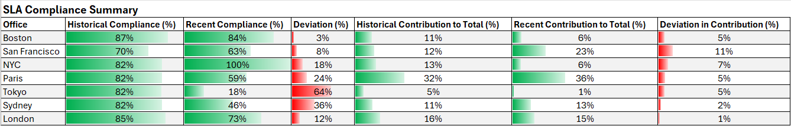
Historical Comparison
Purpose:
Evaluate year-on-year performance to identify long-term trends, patterns, and areas for improvement.
Understand how historical payment inflows and outflows compare with current year trends to assess predictability.
Metrics:
Proportion of Payments Received per Month (%):
Formula: (Payments Received in Month X / Total Payments Received That Year) × 100.
Helps identify when the bulk of payments are received each year and how these patterns evolve.
SLA Compliance Deviations (%):
Formula: Recent Compliance % - Historical Compliance %.
Highlights shifts in delivery performance year-over-year.
Key Decisions:
Why Proportional Payments Metric? Allows businesses to track the timing of payment inflows and assess predictability for future cash flow planning.
Why SLA Compliance Deviations? Focuses on measurable year-over-year delivery performance shifts for strategic interventions.
Use of Conditional Formatting: Quickly identifies months or offices with significant improvements (green) or deteriorations (red).
Notes:
This slide demonstrates how historical data can help businesses identify patterns and make predictions. By comparing past payment inflows to current trends, we help the business gauge whether cash flow timing is consistent year over year.
We calculated the proportion of payments received per month to identify when the bulk of revenue arrives. For instance, in prior years, November and December consistently saw peaks, which aligns with current trends.
By comparing recent SLA compliance to historical performance, we uncover which offices are improving (e.g., Paris) and which are declining (e.g., Tokyo).
Green highlights improvements, such as Paris’s 15% SLA compliance gain, while red emphasizes declines, like Sydney’s 18% drop.
These insights allow management to focus on underperforming areas while leveraging historical trends to predict and plan future operational and financial strategies.

Slide 9
Key Decisions and Challenges
Key Decisions
Metric Selection: Chose relative frequency for fair comparison of SLA compliance across offices with varying workloads.
Data Visualisation: Used conditional formatting (green/red) to highlight top/bottom performers for clarity.
Comparison Logic: Focused on historical vs. recent data to identify trends and prioritize actions.
Challenges
Dynamic Data: Managing datasets with varying lengths required robust coding for dynamic ranges.
Chart Consistency: Encountered issues with getting charts to display and update consistently.
Macro Optimisation: Split into 7 separate macros to ensure smooth execution and prevent Excel crashes.

Slide 10

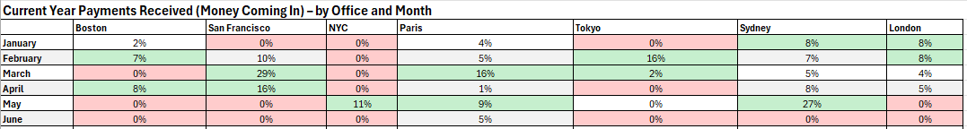
Summary Dashboard and Business Benefits
Purpose:
The Summary Dashboard consolidates key performance metrics (sales, payments, SLA compliance) into a single view.
Demonstrates the value of automation by streamlining decision-making with real-time data visualization.
Key Business Benefits:
Improved Decision-Making: Highlights actionable insights such as monthly trends, payment inflows, and SLA compliance to support strategic decisions.
Time-Saving Automation: Eliminates manual data consolidation, providing accurate and up-to-date reports in seconds.
Cash Flow Management: Tracks "money in" vs. "money out," ensuring potential issues like late payments are flagged proactively.
Error Reduction: Automates calculations and visualizations, minimizing manual errors in data handling and reporting.
Enhanced Performance Tracking: Uses conditional formatting (green for top performers, red for underperformers) to focus management attention on areas needing improvement.
Scalability: Can handle dynamic datasets as the business grows or reporting requirements change.

Slide 11

Conclusion
Summary of Achievements:
Delivered a dynamic, automated solution for analyzing sales, deliveries, and payments.
Provided actionable insights through structured data visualization and analysis.
Enhanced efficiency, reduced errors, and saved time with VBA automation.
Next steps for the Business:
Utilise the dashboard to make data-driven decisions.
Continue refining automation based on user feedback.

Slide 12

Thank you for your attention. Do you have any questions?

